Slide 1

Programming with JavaScript and jQuery
Chapter 12:
Intro to jQuery

Slide 2
Introduction to jQuery
jQuery
Commonly used library
Enables developers to implement common JavaScript tasks with minimal code
Documentation, tutorials and downloads are available at https://jquery.com

Slide 3
Implementing jQuery
Cross-browser library:
jQuery 1.x supports IE 6, 7, and 8
jQuery 2.x supports only IE 9 and later
Requires less extra code, so smaller file
jQuery 3.x supports more HTML5 elements

Slide 4
Including the Library
Link the jQuery .js file containing the library to HTML document
Can download from jquery.com
Or, you can specify public location on Content Delivery Netowork (CDN), for example:
<script src="https://ajax.googleapis.com/ajax/libs/jquery/3.2.1/jquery.min.js"></script>

Slide 5
Exercise: Life on Rocks
In the WA120_data_files folder, open the folder for Chapter 12.
In the chapter sub-folder, copy all of the contents.
Navigate to where you normally save your work and create a new folder named “on_rocks”.
Paste the copied data files into this folder.

Slide 6
Exercise: Life on Rocks
Download the latest version of jQuery and place those files in your “on_rocks” project folder.
Modify the script element that you add in step 5 of page 816 to include the latest version of jQuery.

Slide 7
Starting a jQuery Statement with $
All jQuery code conforms to JavaScript rules
However, it uses shortcuts that can look like different language (!).
Every jQuery statement begins with $
This symbol specifies that any code that follows should be interpreted using the jQuery library.

Slide 8
Selecting Elements with jQuery
The $ is followed by a reference to the elements on which the statement operates
Reference is contained in parentheses
Use CSS selector in quotes to select elements
Example–to operate on h1 elements:
^{$("h1")}
Example—to select elements in the odd class:
^{$(".odd")}
This is a concise version of the querySelectorAll() method: document.querySelectorAll(".odd")

Slide 9
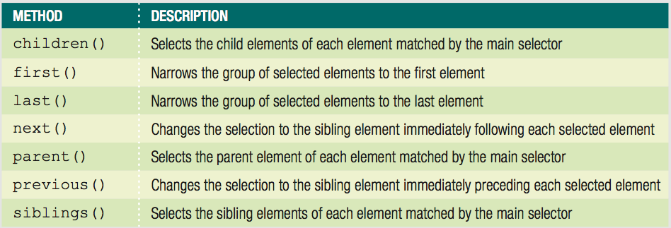
Traversing the DOM with jQuery Methods
Can select other elements in relation to selection
Use jQuery DOM traversal methods
Table 12-1 jQuery methods for DOM traversal

Slide 10
Traversing the DOM with jQuery Methods
Select children of original selection:
^{$("ul.mainmenu li").children()}
Narrow selected items with selector in method's parentheses:
$("ul.mainmenu li").children("ul")
Selects all children of the original selection
Selects only the ul elements that are children of each list item mentioned in the literal selector

Slide 11
Manipulating the DOM with jQuery Methods
Plain JavaScript (sometimes called “Vanilla”)
Refers to JavaScript without jQuery
jQuery API includes methods for performing actions on selected elements.
Some of the most powerful are the methods that enable you to manipulate the DOM elements.

Slide 12
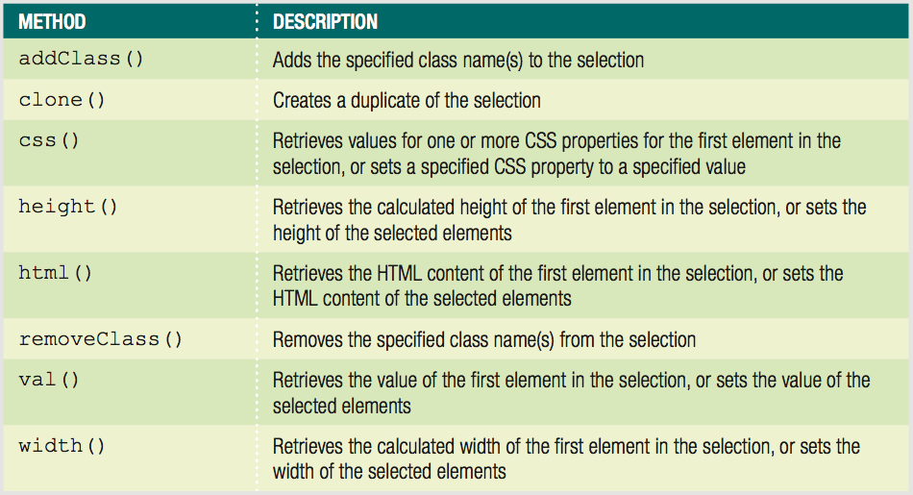
Manipulating the DOM with jQuery Methods
Table 12-2 jQuery methods for manipulation

Slide 13
Manipulating the DOM with jQuery Methods
Many jQuery methods serve dual functions
Look up a value
Set that value to something new
^{$(".odd").width();}
/* returns the computed width value for the first element with the class name "odd" */
^{$(".odd").width("5em");}
/* sets the width of all elements with the class name 6 "odd" to 5em */

Slide 14
Specifying an Event Handler
You can group jQuery statements into functions using standard JavaScript syntax
^{function display() {}
$("ul.mainmenu li").children("ul").addClass("show");
}
As in plain JavaScript, you can use a named function as an event handler with jQuery by creating an event listener.

Slide 15
Specifying an Event Handler
Backward-compatible event listener easier in jQuery
Start with $
Specify selector for element(s) associated with event
Finish with method that specifies event and action(s)

Slide 16
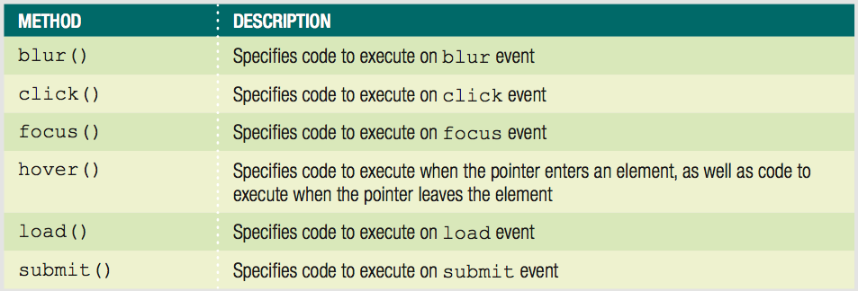
Specifying an Event Handler (cont'd.)
Performs as described with function in ()
Empty () instead fires indicated event
Table 12-3 jQuery methods for common events

Slide 17
Specifying an Event Handler
Performs as described with function in ()
Empty () instead fires indicated event
Table 12-3 jQuery methods for common events

Slide 18
Specifying an Event Handler
$("form.order").submit(validateForm);
/* specifies validateForm() as event handler when the ^{form is submitted */}
^{$("form.order").submit();}
/* fires submit event on form */

Slide 19
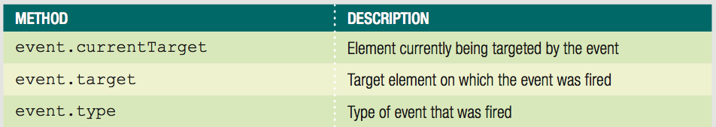
Specifying an Event Handler
Table 12-4 jQuery event properties

Slide 20
Exercise: Life on Rocks
Return to “script.js” in Notepad ++
Enter the code on pages 823 and 824 to create new functions and an event listener using jQuery.

Slide 21
Short Quiz 1
What is the first step in using jQuery in a project?
How does every jQuery statement start?
How do you select elements in jQuery?

Slide 22
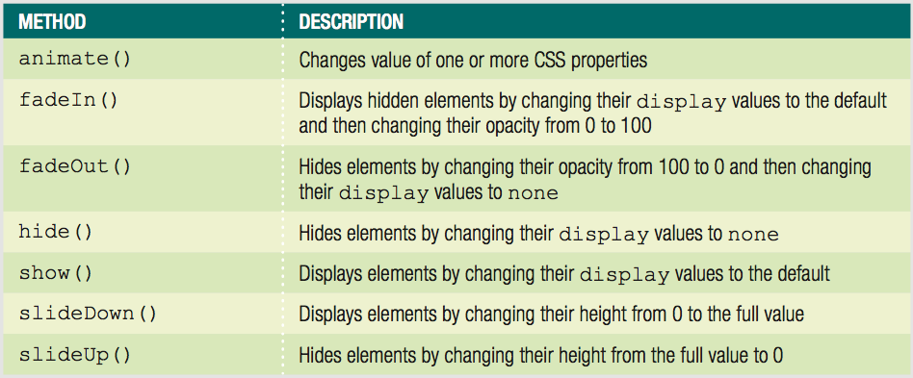
Using jQuery Built-in Effects
jQuery includes visual animation methods
Table 12-4 jQuery animation methods

Slide 23
Using jQuery Built-in Effects
All methods take a value in milliseconds as an argument:
Animation occurs in the specified time frame
Some also support slow and fast keywords

Slide 24
Exercise: Life on Rocks
Return to “script.js” in Notepad ++
Enter the code on pages 826 – 828 to add jQuery built in animations to the submenus.

Slide 25
Short Quiz 2
What argument do all jQuery animation methods take?
What is the difference between using the jQuery addClass() method and the show() method to display an element with the display property value set to none?

Slide 26
AJAX
Traditionally webpages required reloading to update their content. For web-based email this meant that users had to manually reload their inbox to check and see if they had new mail. This had huge drawbacks: it was slow and it required user input. When the user reloaded their inbox, the server had to reconstruct the entire web page and resend all of the HTML, CSS, JavaScript, as well as the user's email. This was hugely inefficient. Ideally, the server should only have to send the user's new messages, not the entire page. By 2003, all the major browsers solved this issue by adopting the XMLHttpRequest (XHR) object, allowing browsers to communicate with the server without requiring a page reload.
The XMLHttpRequest object is part of a technology called Ajax (Asynchronous JavaScript and XML). Using Ajax, data could then be passed between the browser and the server, using the XMLHttpRequest API, without having to reload the web page. With the widespread adoption of the XMLHttpRequest object it quickly became possible to build web applications like Google Maps, and Gmail that used XMLHttpRequest to get new map tiles, or new email without having to reload the entire page.
https://learn.jquery.com/ajax/

Slide 27
AJAX
Ajax requests are triggered by JavaScript code; your code sends a request to a URL, and when it receives a response, a callback function can be triggered to handle the response. Because the request is asynchronous, the rest of your code continues to execute while the request is being processed, so it's imperative that a callback be used to handle the response.
Unfortunately, different browsers implement the Ajax API differently. Typically this meant that developers would have to account for all the different browsers to ensure that Ajax would work universally. Fortunately, jQuery provides Ajax support that abstracts away painful browser differences. It offers both a full-featured $.ajax() method, and simple convenience methods such as $.get(), $.getScript(), $.getJSON(), $.post(), and $().load().
Most jQuery applications don't in fact use XML, despite the name "Ajax"; instead, they transport data as plain HTML or JSON (JavaScript Object Notation).
https://learn.jquery.com/ajax/

Slide 28
Summary
jQuery enables developers to implement common tasks with minimal code
Must link .js file containing library to HTML document
Every jQuery statement starts with $
Select elements in jQuery with CSS selector in quotes
Can modify a selection
Append DOM traversal method to selection code

Slide 29
Summary
jQuery API includes methods for performing actions on elements
Many methods allow you to look up or set value
Event listener consists of
$
selector
method
jQuery includes visual animation methods

